Slide 1

PHASE II FINAL
Final demo
Team rssf
Oct 2019

Slide 2
SYSTEM ADVANTAGES
The Blind Buddy Visually Impaired Navigational Assistance Application (BBVINAA) is robust, modular, and expandable.
Simplistic and easy to use setup system.
Accessible and made specifically with visually impaired individuals in mind.

Slide 3
ROBUST
Since users will rely on the apps ability to continuously function as a navigational assistant it is key that it does not break or shutdown during use.
Built using the Google Maps Platform which has been trusted and utilized by many.
System uses error catching to ensure that the app continues to run and assist the user in the unlikely event that an error does occur.

Slide 4
MODULAR
System divided into multiple components, which not only lowers the likelihood of errors, but also lessens the impact of errors if they occur.
Modular design allows for much more flexibility of the application so changes can be made easily and efficiently.

Slide 5
EXPANDABLE
Made with future updates and improvements to app in mind.
Easy to integrate newer technologies, maps, and location providers.
Continuous improvements will create a greatly improved user experience.

Slide 6
SCOPE CREEP (PREVIOUS)
Because of the difficulty of the semester, our team has almost no room for scope creep.
Future unseen challenges predicted in building this app may prove very difficult.
Team has little experience with mobile development.
Possibilities with third-party software such as Google Indoor Maps unknown.
General clearness that emerges with the development process will reveal unforeseen challenges.
We will do our best to keep up with it.

Slide 7
SCOPE CREEP (CURRENT)
Difficult semester left little room for scope creep as predicted
Result of unseen challenges
Mobile development
Google Maps platform
Mapwize API
Emulator limitations

Slide 8
FUNCTION POINTS

Slide 9
FUNCTIONAL REQUIREMENTS
P FR_ ID | Preliminary FR Description
PFR1 | Accepting from the user the destination location to go
PFR2 | Figuring out the routes to reach each destination
PFR3 | Informing the user of the routes to reach the destination
PFR4 | Informing the user to walk a certain distance
PFR5 | Informing the user to stop at the right place to turn
PFR6 | Detecting obstacles and informing the user how to avoid them
PFR7 | Placing emergency calls and messages
PFR8 | Detecting when the user falls
PFR9 | Predict the user’s next actions based on the user’s schedule and habits

Slide 10
COMPLEXITY RATE
Functional Requirement | Category | Complexity (Rate 0-10)
PFR1 | External Inputs | 5
PFR2 | Internal Logical Files | 9
PFR3 | External Outputs | 3
PFR4 | External Outputs | 3
PFR5 | External Outputs | 3
PFR6 | External Inquiries | 10
PFR7 | External Interface files | 5
PFR8 | External Inputs | 10
PFR9 | External Inquiries | 10

Slide 11
FP COUNT
Type of Component | Complexity of Components
 | Low (x3) | Average (x4) | High (x6)
External Inputs | 45 | 60 | 90
External Outputs | 27 | 36 | 54
External Inquiries | 60 | 80 | 120
Internal Logical Files | 27 | 36 | 54
External Interface files | 15 | 20 | 30
Total | 174 | 232 | 348

Slide 12
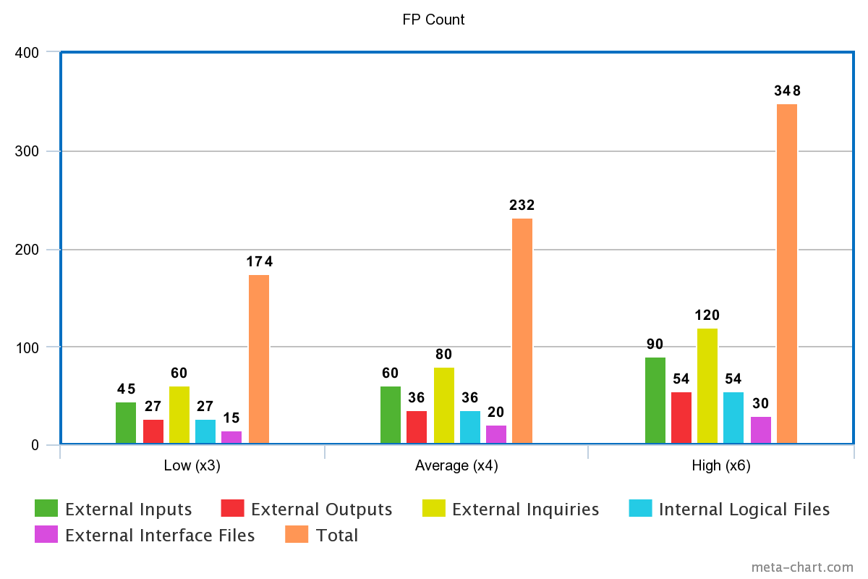
FP COUNT

